Slide 1
Chun Hua Catherine Dong
Shayla Taylor, Kirsten Couzens, Adrienne Kaye, Aidin Lysyshin, Ekatrina Milanovski, Amy Hameluck, John Pacholik, Kiran, Vaibhav Sharma, Yupeng Yang

Slide 2
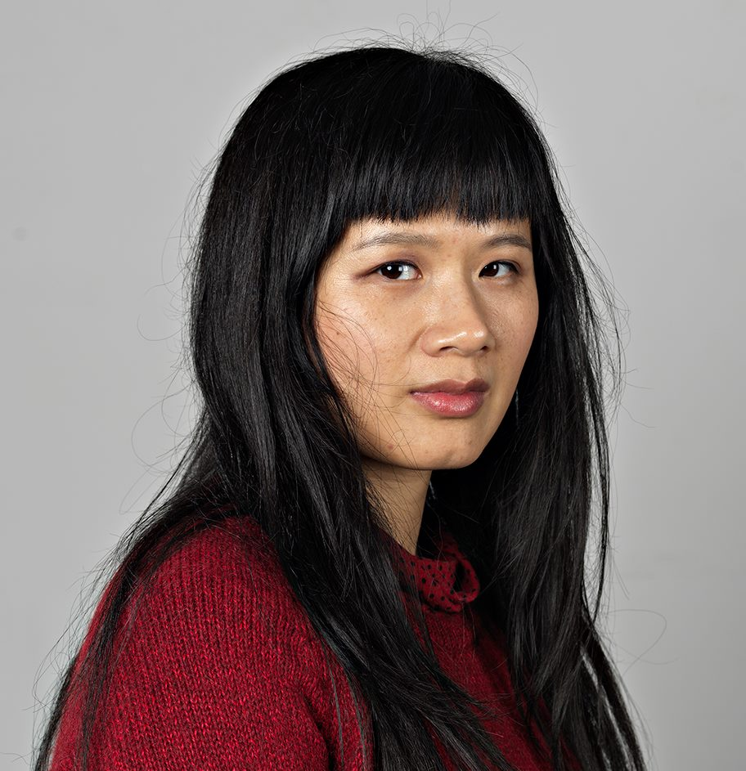
Biography
Born in China
Chinese born Montreal based visual artists
Performance, photography, and video
She was the recipient of the Franklin Furnace Award for contemporary avant-garde art in New York in 2014
She was listed the “10 Artists Who Are Reinventing History” by Canadian Art in 2017.
Education
BFA, Emily Carr University Art & Design, Vancouver (2011)
MFA, Concordia University, Montreal (2015)
Notes:
http://chunhuacatherinedong.com/cv/
Chun Hua Catherine Dong is a Canadian performance artist who was born in China. She operates out of Montreal, but does her performance pieces all around the world. Her most popular collection is called “I Have Been There” and she started it in 2015. This collection has many different editions in places all around the world. “She received a BFA from Emily Carr University Art & Design and MFA from Concordia University in Canada” (Dunlop Learning). She has performed at multiple festivals and galleries globally including Toronto, Dublin, Houston, Santiago, Mannheim, Montreal, California, and many more locations. (Script by John Pacholik)

Slide 3
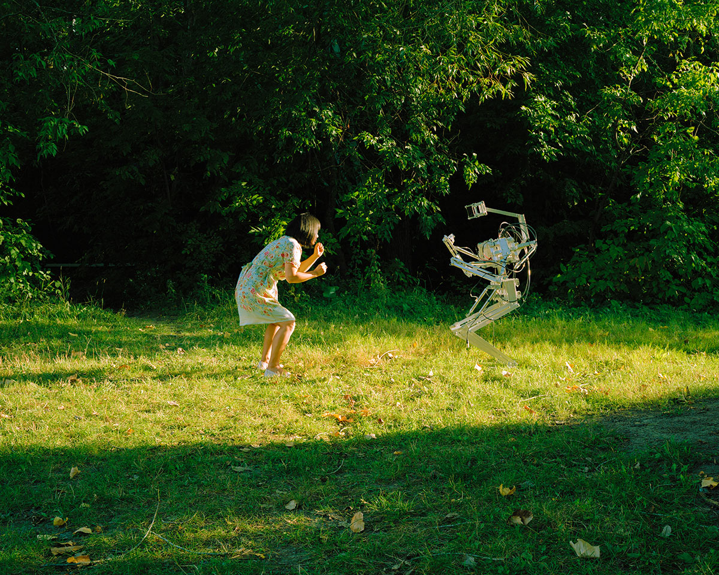
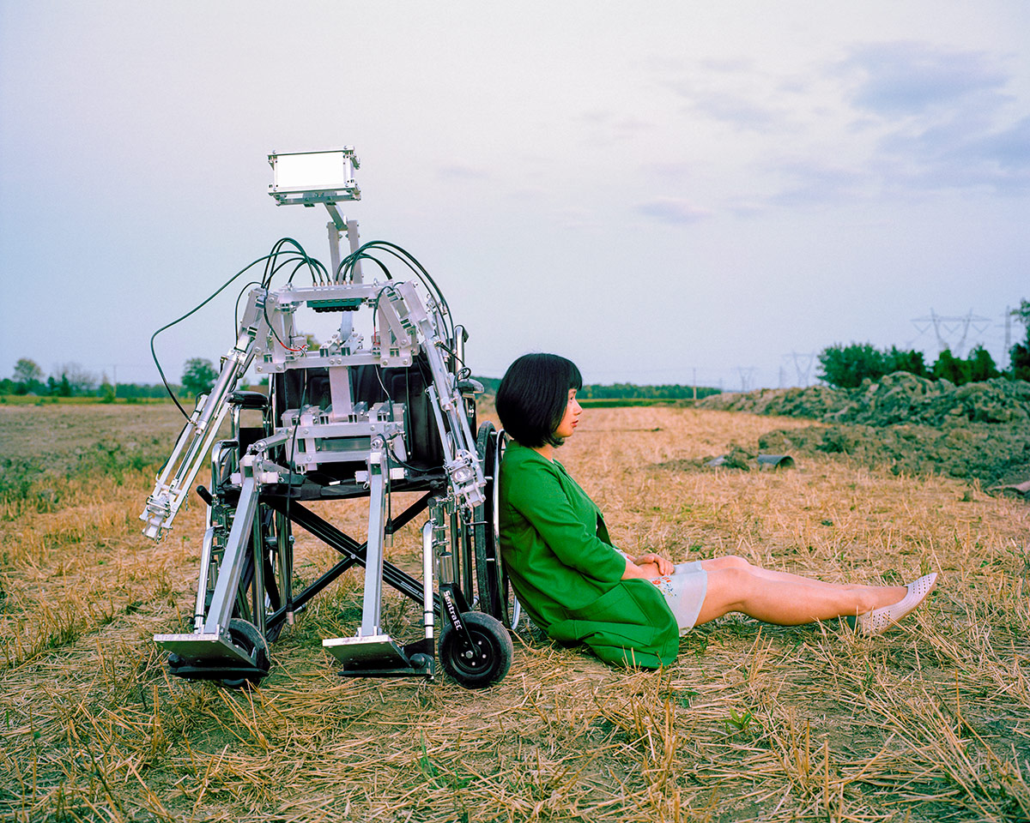
Alone Together
Chun Hua Catherine Dong, Alone Together, 2018, photographs, variety of sizes.
Notes:
Alone Together - Chun Hua Catherine Dong
Performance piece consisting of 15 photographs and a video
Look into the future, to explore how humans and robots can coexist and bind together
Challenges the modernization of society and puts question to “Where are we going?”
Demonstrates not only a profound challenge in modern civilization, but also a fundamental transition in our global future
With the performance piece, provides alternative perspective for a better understanding of ourselves, our bodies, our emotions, and our relations with non-human others. (Shayla Taylor)

Slide 4
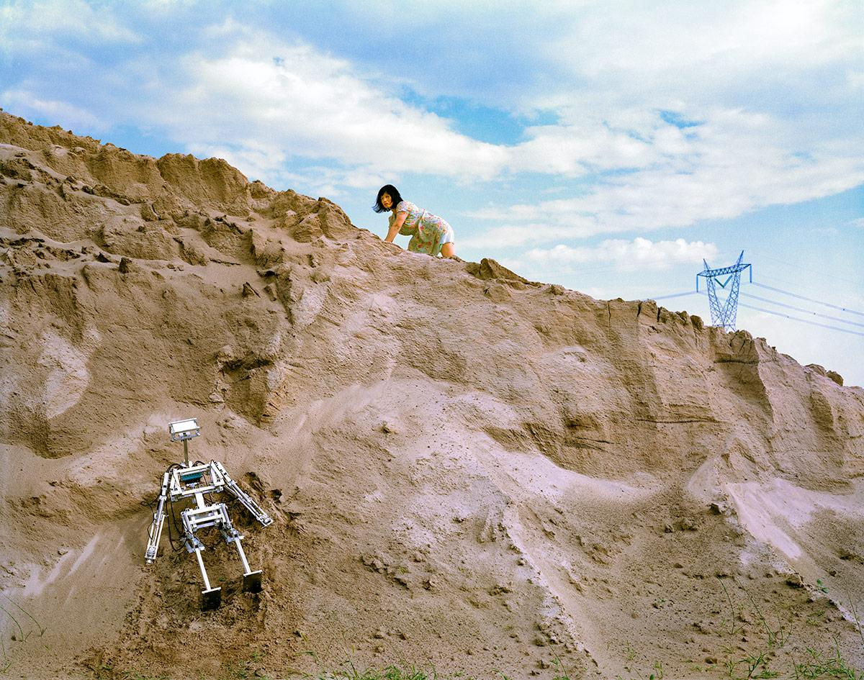

Alone Together
Chun Hua Catherine Dong, Alone Together, 2018, photographs, variety of sizes.
Notes:
Alone Together also raises questions about binary system, about how to challenge boundaries of self/other, culture/nature, and human/machine, moving beyond traditional gender, feminism, and politics, creating a new social relation that expands and amplifies humanity
In the performance video she is doing everyday activities such as getting groceries, riding the bus, and walking through the park with a robot in a wheelchair. She videos how the people around her are reacting to the robot and how curious they get. (Shayla Taylor)

Slide 5
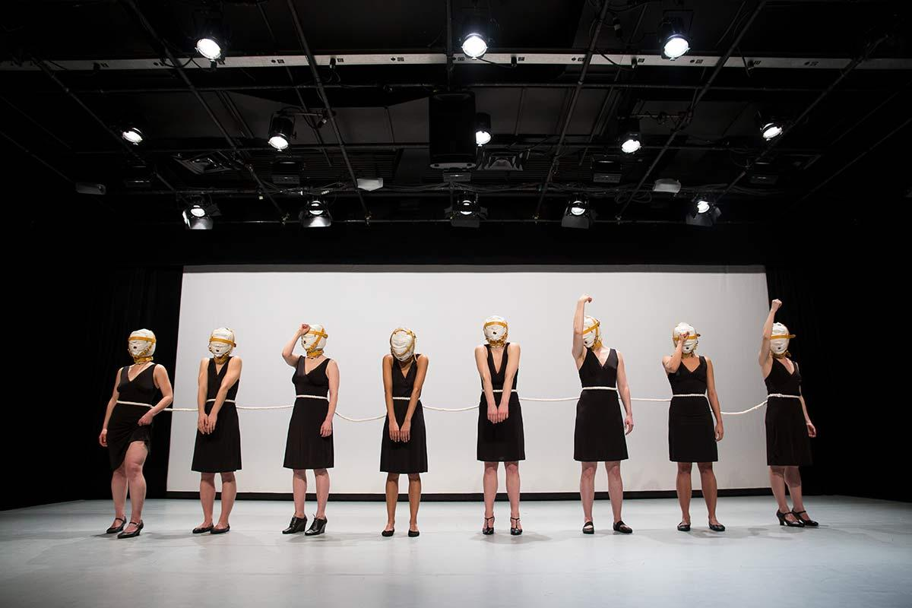
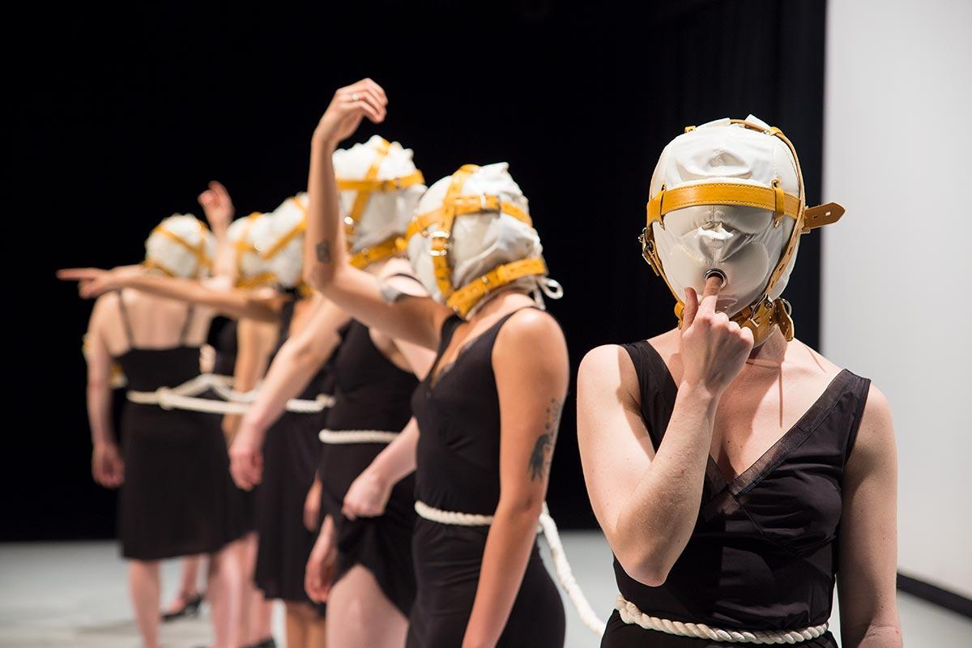
The Sign
Chun Hua Catherine Dong, The Sign, 2017, performance pieces, 60 minutes.
Notes:
The Sign is part of the ongoing series by Chun da Cathrine's Dong that explores the concept of shame using contemporary art. In this artwork, eight different women are tied with a string of rope together while there faces are covered with a mask. All these women hold different symbolic gestures which keep changing every two minutes. All the gestures performed by the women are considered shameful but offensive according to the current society, such as, sniffing their armpits, sucking their fingers, lifting up their dresses and so on. This 60 minutes video performance is available on youtube, Vimeo and her website and I suggest everyone to definitely check it out.
Catherine dong is using this artwork to represent how society tries to control citizens- especially women- to make sure they act according to they set standard or status. Catherine dong is a well known feminist and she is trying to show society how they silently make women feel vulnerable and performative gestures seen in this art are a challenge to the norm set by the society. In this ongoing series against shame, Cathrine use her experience as a child in china where the concept of shame is in the face so she keeps it covered. The symbolic gesture of wearing a mask represents how women are restricted by their doctrines to be themselves due to the social norms set by the society. This installment of this series did wonders in bringing awareness to feminism and empowering women to go against pressure to conform with society. (Vaibhav(kv))

Slide 6
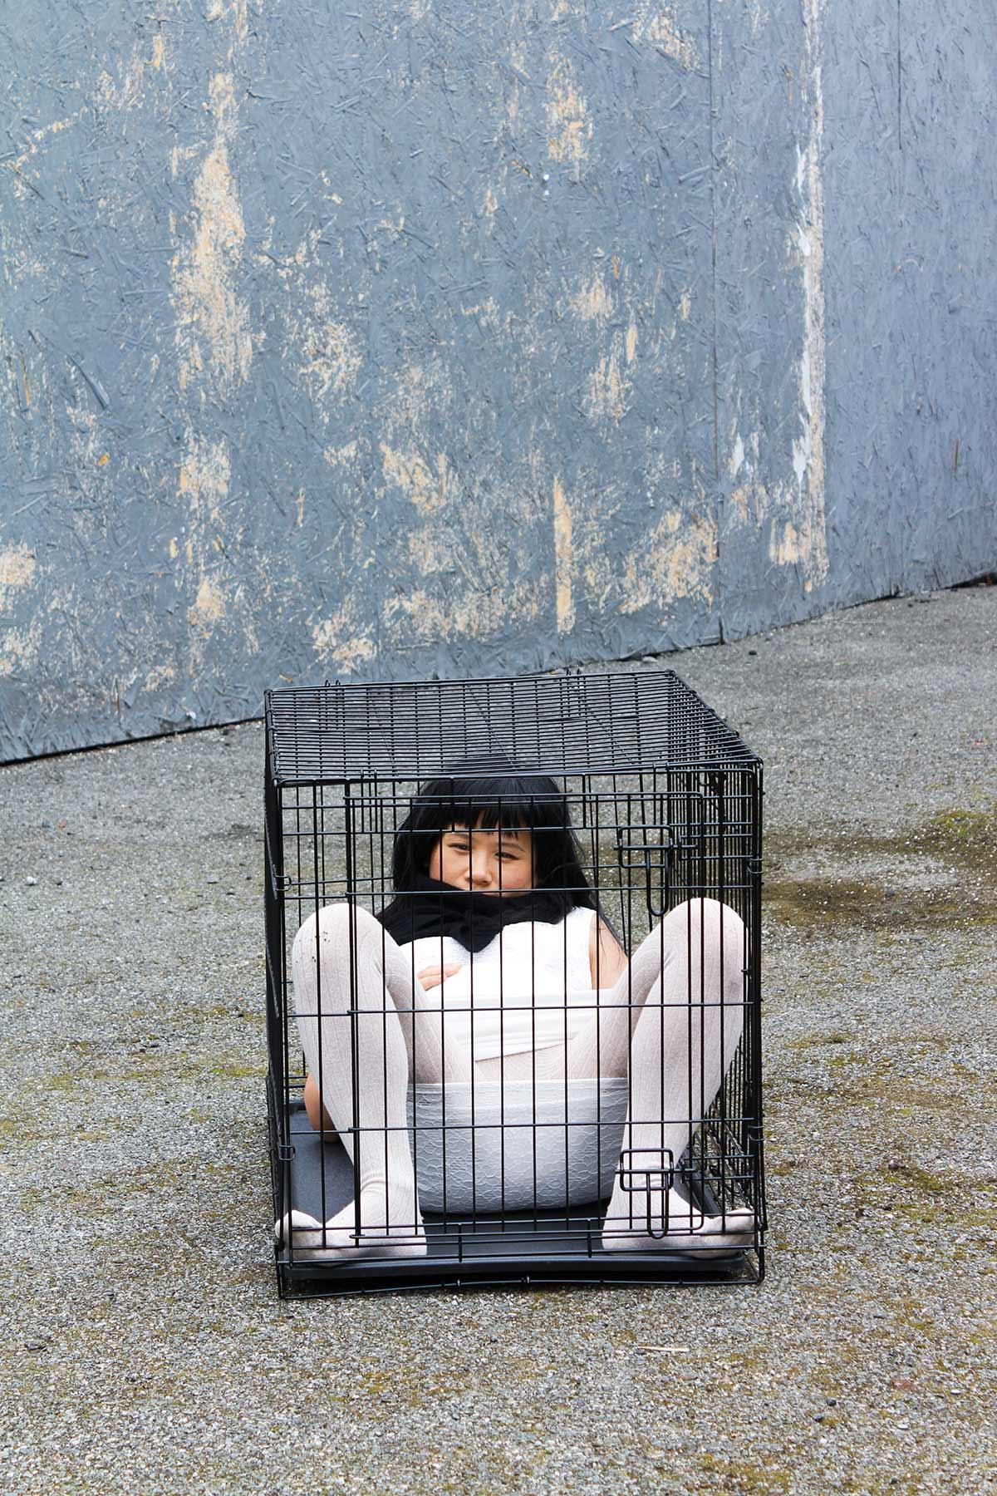
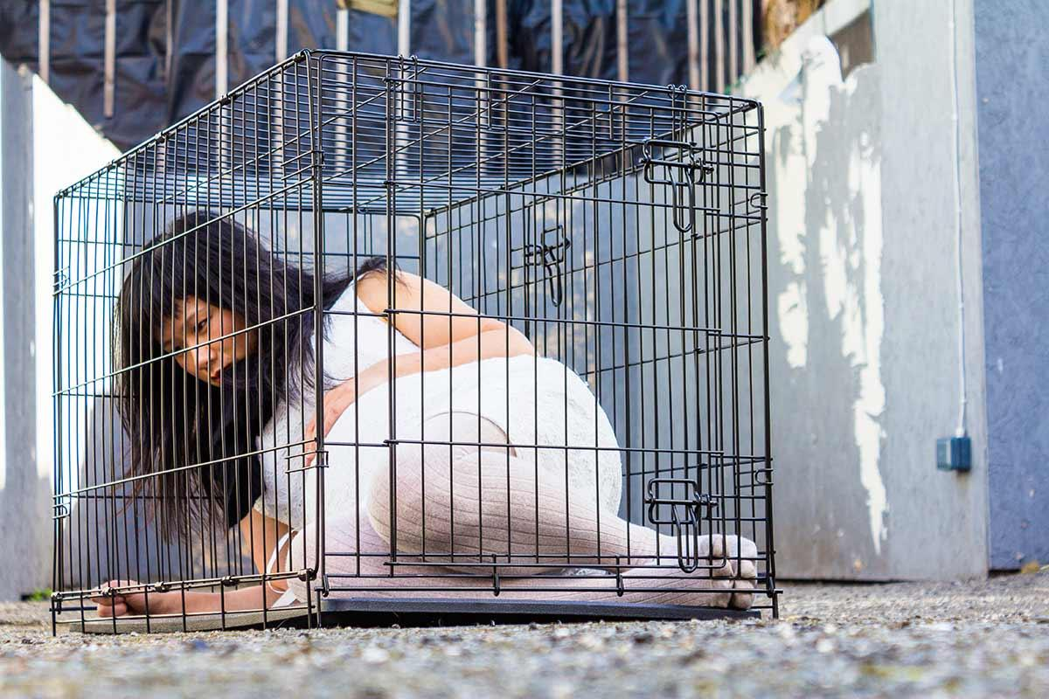
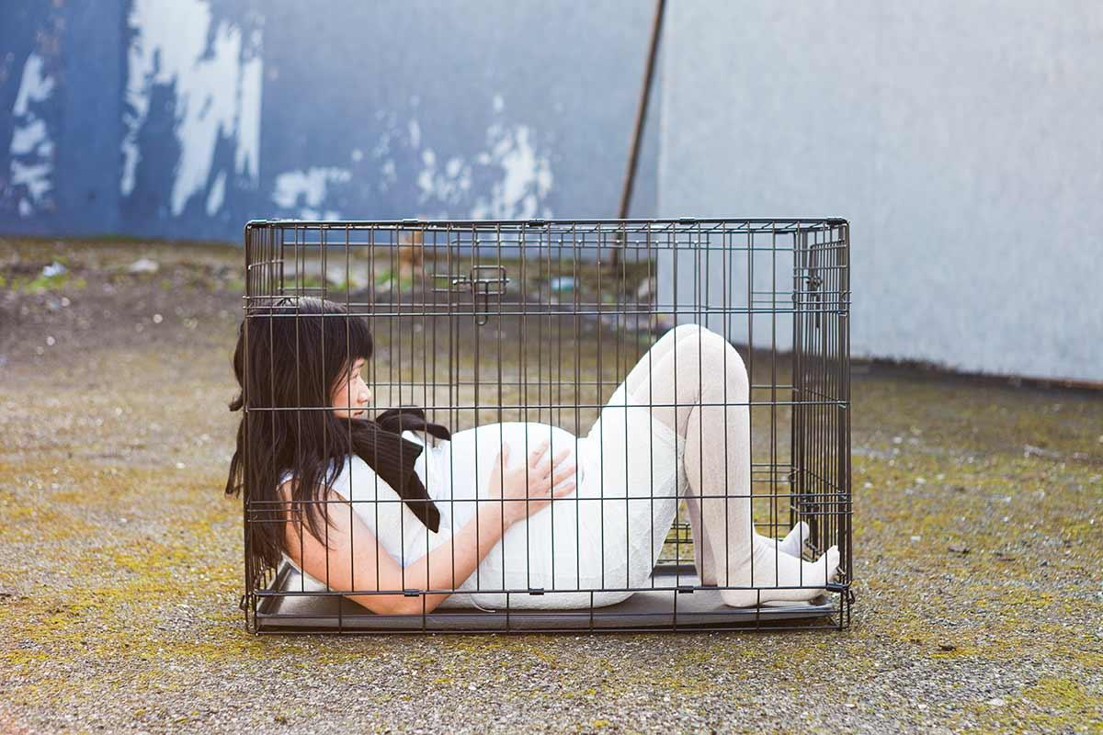
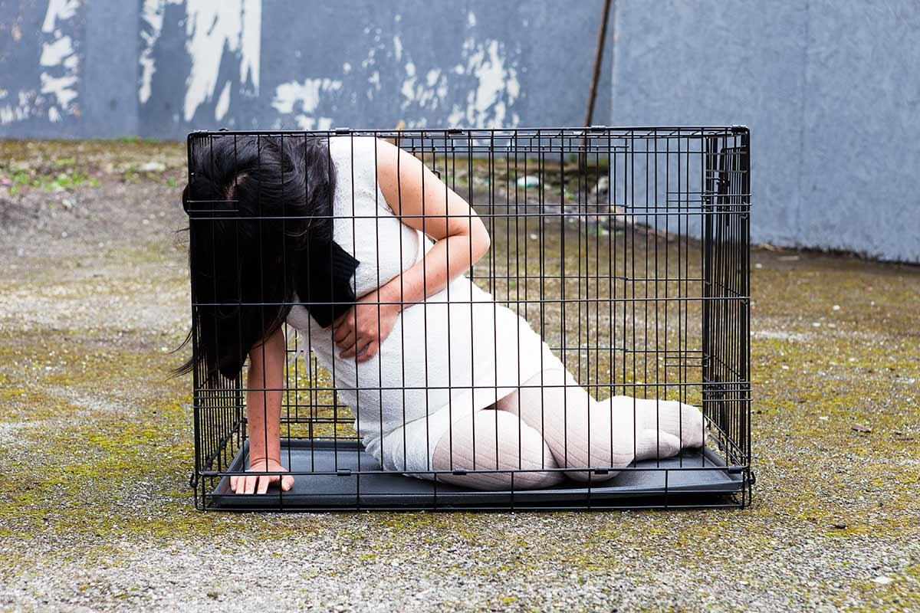
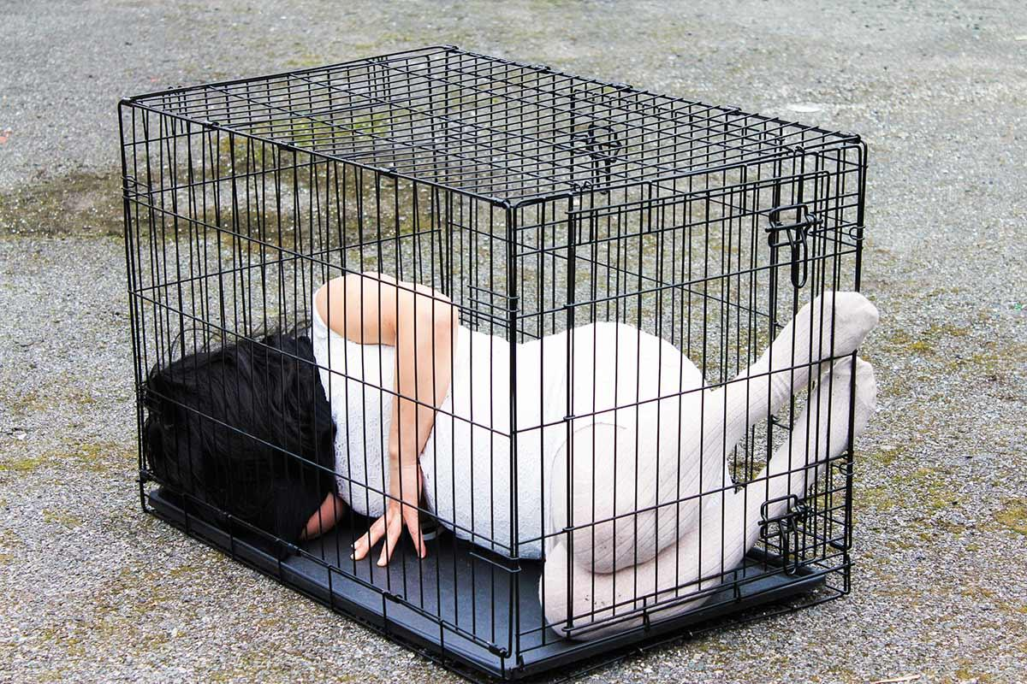
Pregnancy
Chun Hua Catherine Dong, 10 day performance in the city of Dublin, Ireland, 2014.
Notes:
Chun Hua Catherine Dong’s Pregnancy is a 10 day performance piece that took place in various public spaces in the city Dublin, Ireland. September 2014 Catherine traveled to Ireland to participate in an abortion rights campaign in response to a case involving an eighteen year old pregnant rape victim who was denied an abortion. Upon arrival Catherine transformed herself into a pregnant woman and spent all 10 days with the fake pregnancy stomach participating in things like marches. The photos above are from a six hour performance where she locked herself in a dog cage in a public space for everyone to see. In Ireland they denied that girl an abortion but in China they used to have the “One-Child Policy” which encouraged and often forced women to get abortions. Abortion is an important topic to Catherine because she believes that every woman deserves the right to make decisions about their own bodies, whether that decision is to have an abortion or not to. The role of artists Catherine is fulfilling in this piece is “artists help to see the world in new or innovative ways”. By locking herself in the dog cage is forces the audience to look at abortions through a new perspective. It was bold and made a statement in a way that was new, maybe even a little shocking to some. (Aiden)

Slide 7


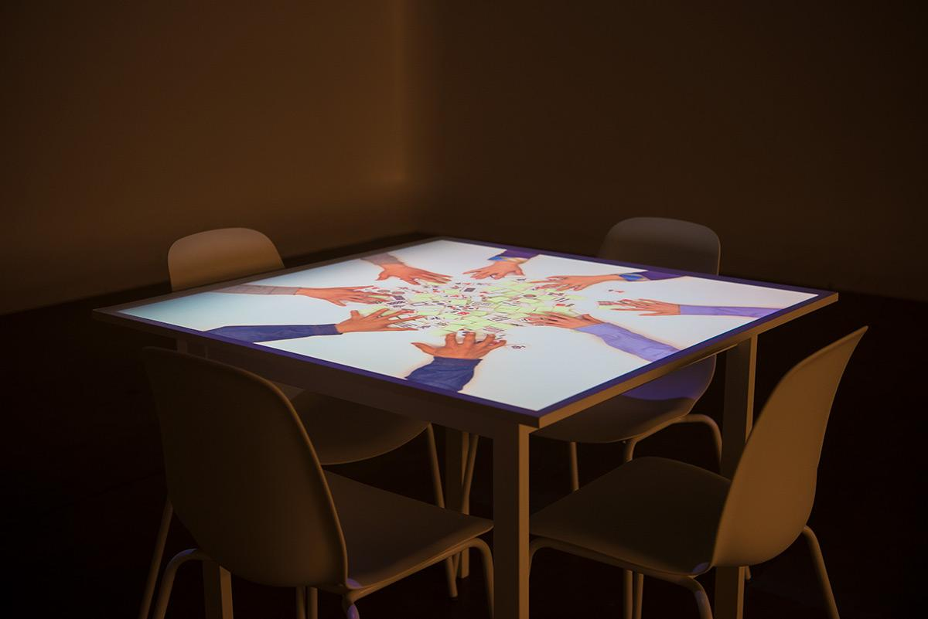
Everywhere and All at Once
https://chunhuacatherinedong.com/portfolio/4781/
Notes:
Chun Hua Catherine Dong’s Everywhere and All at once is a eight channel video installation that concentrate on how to bring chinese together by playing traditional game named ”Mahjong ”. The game is played by four people . Chinese immigrants brought that game into North America in 1920’s which give them a sense of cultural bond there.
The work takes audience to a playful journey of reality and virtuality. In the centre of four chairs , videos are projected and the audience is addressed to sit and watch the videos on their own table. Videos do not cover the players’ identity but it does show the hands, arms and the playing gestures which give the audience a feeling of playing on their own table. This works show the possibilities that can make the people feel together, share culture by mean of Mahjong.(Kiran).

Slide 8
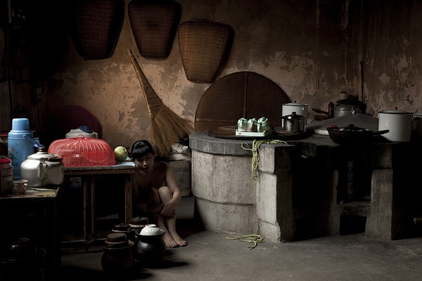
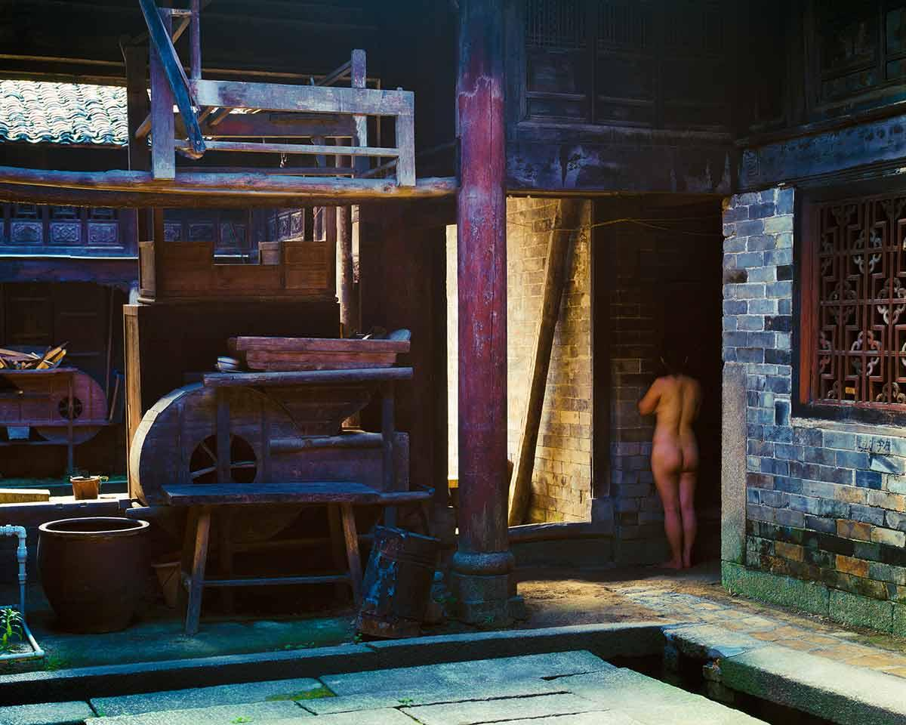
Visual Poetics of Embodied Shame- State of Grace
Chun Hua Catherine Dong, three days in HuNan, China, 2013,photographs
Notes:
Those performance-based photographs record Catherine Dong revisiting the village where she was born. In those 15 piece of photos, Catherine is trying to conceal herself into the shadows and corners. According to her description, she takes the meaning of the word “shame,” “to hide,” like playing hide and seek: to hide in order to cover the shame, to seek in order to find the origin of her shame. And in fact, the players play the role of both seeker and hider which means to find their own “shame”.
Another opinion that she wants to illuminate is the “past” and that seems to be the reason her made this series of artwork at her hometown.In the past few decades, especially in the rural areas of China, female has long been considered as nothing but a mouth to feed. And it terms out it is “shame” to have a girl in a family. In Catherine’s practice, she considers feminism, globalization and psychoanalysis, positioning shame as a feminist strategy of resistance—an ethical practice that seeks altered states of consciousness that possibly leads to restore dignity and humanity. (Yupeng)

Slide 9
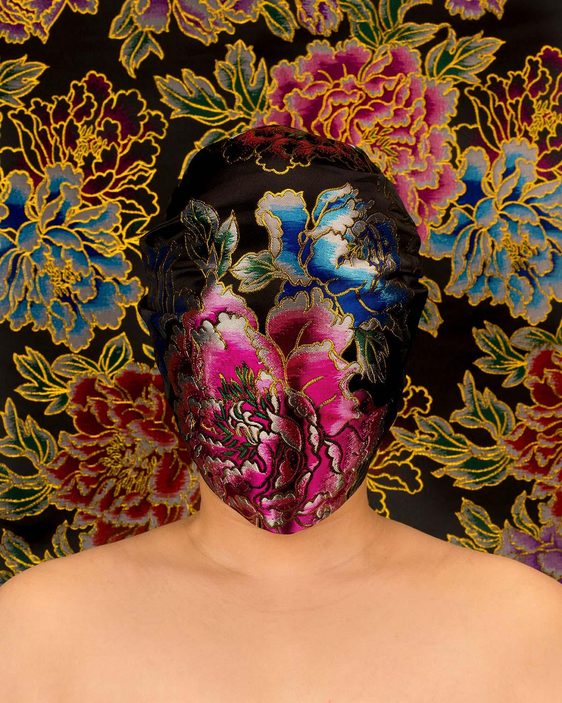
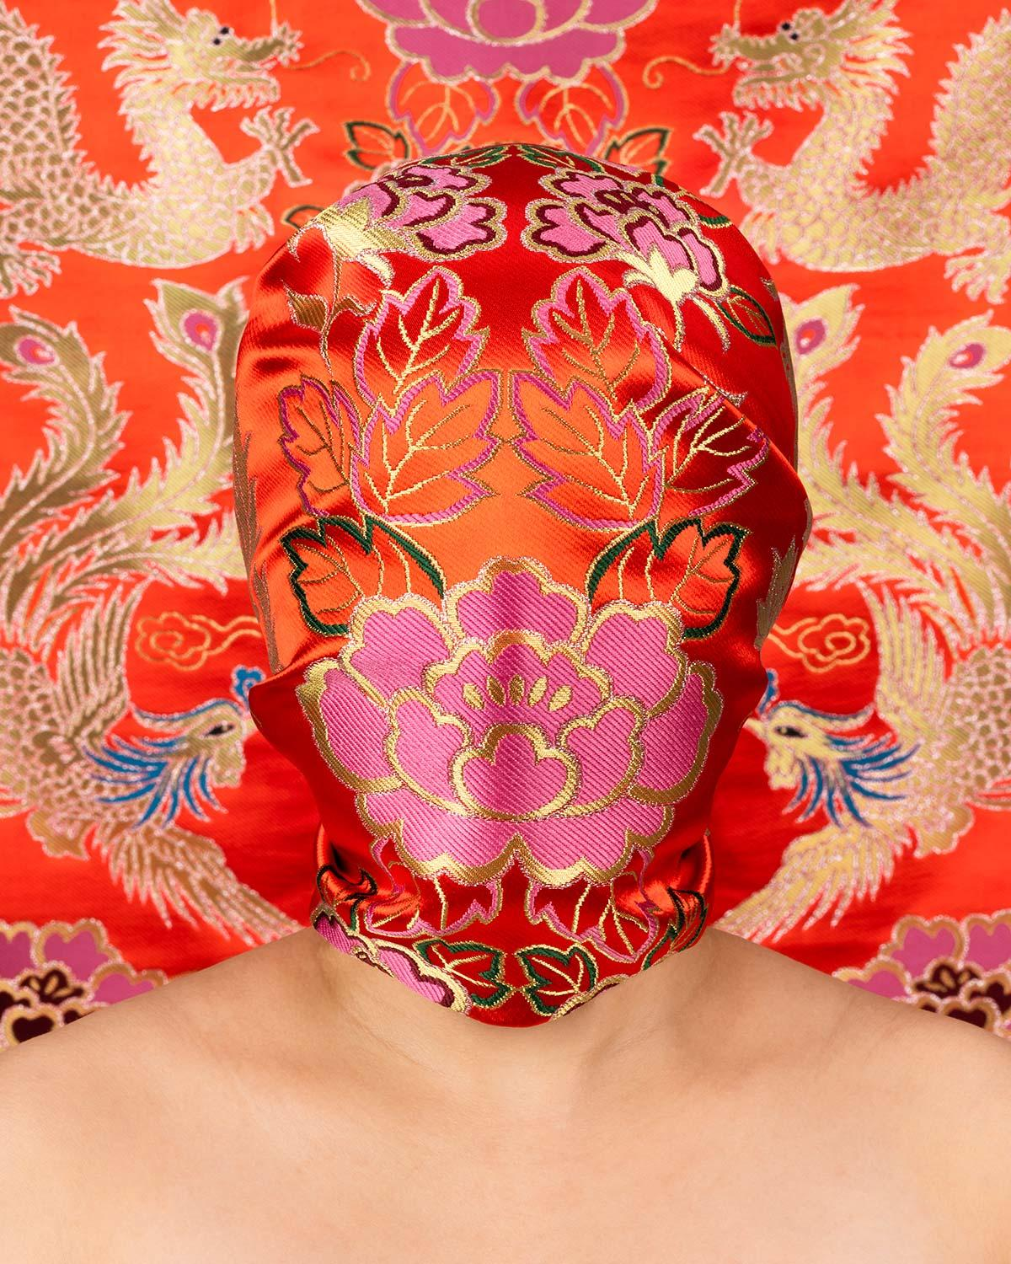
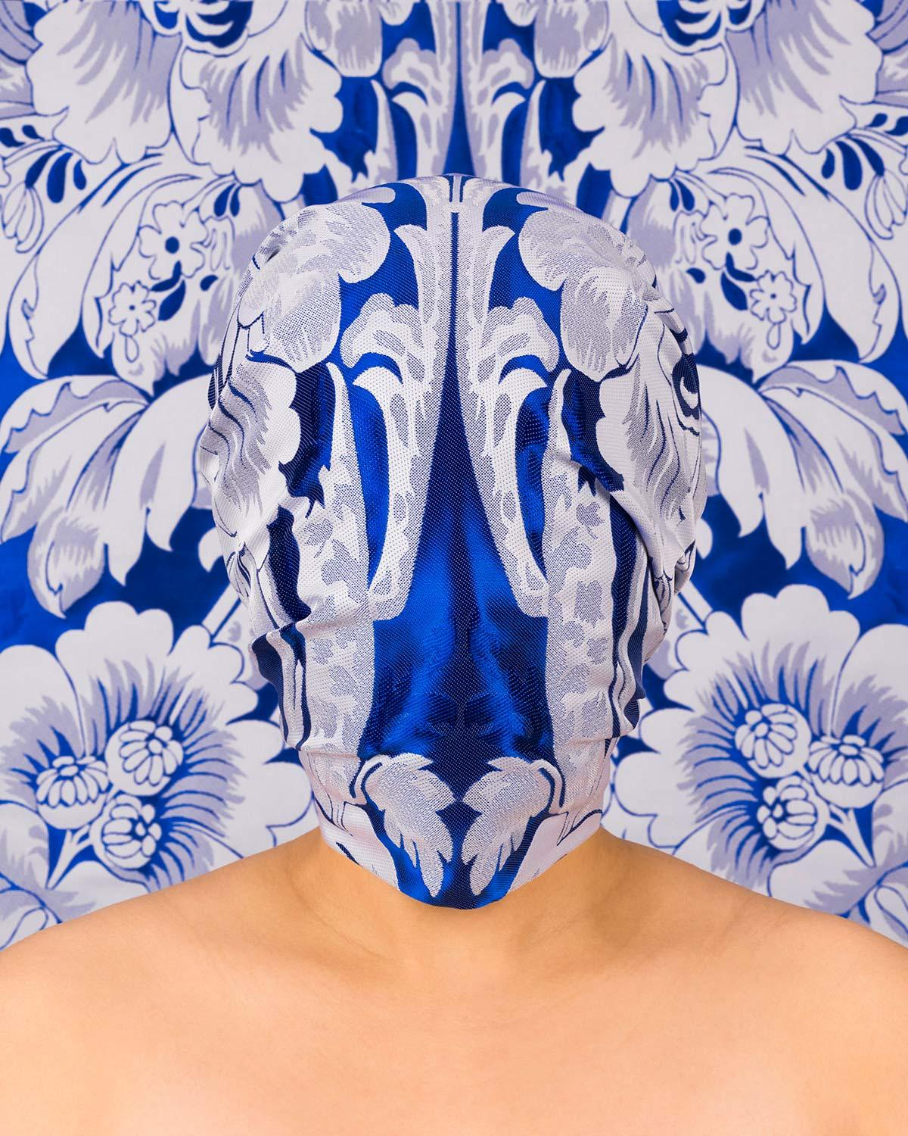
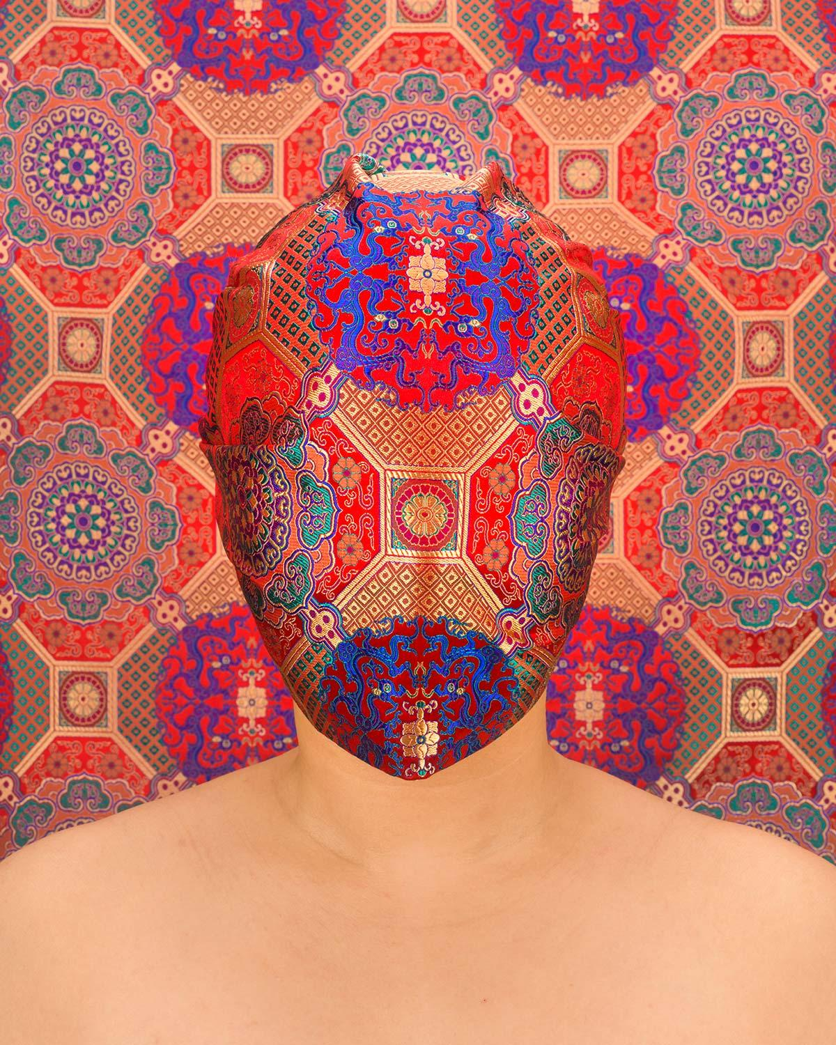
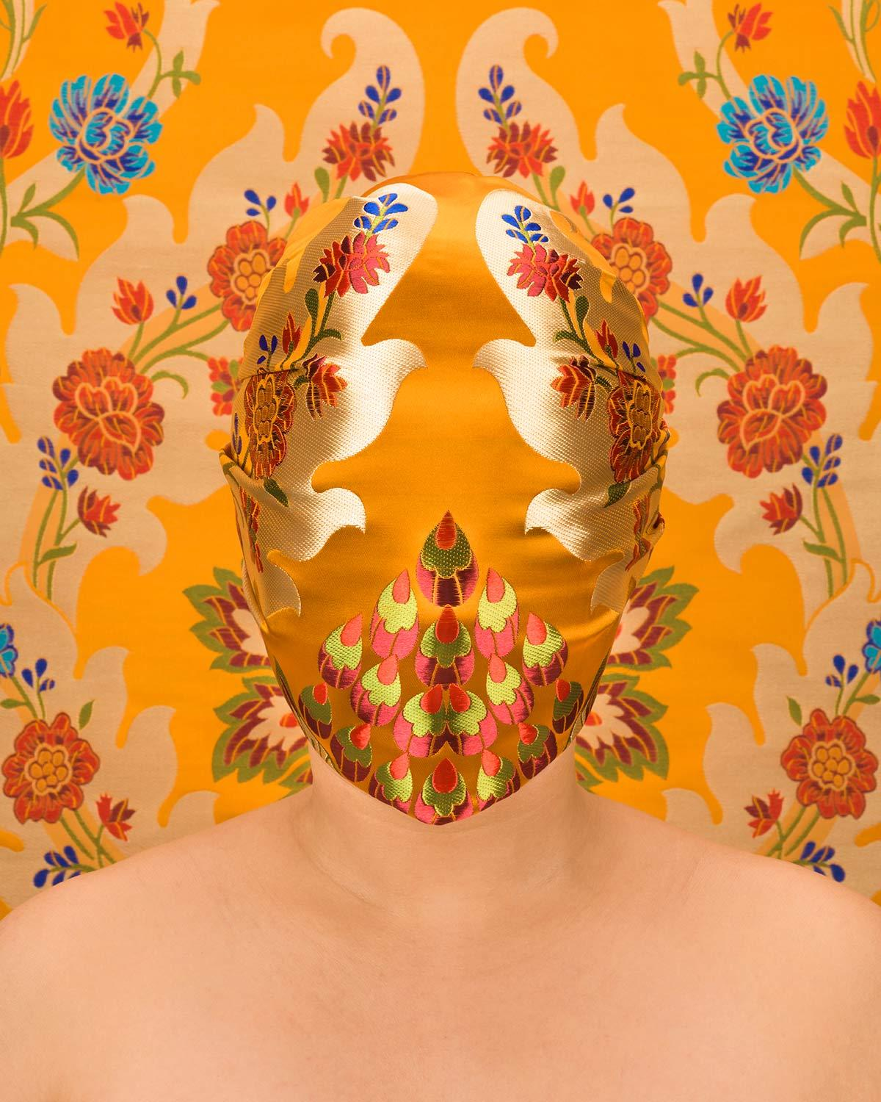
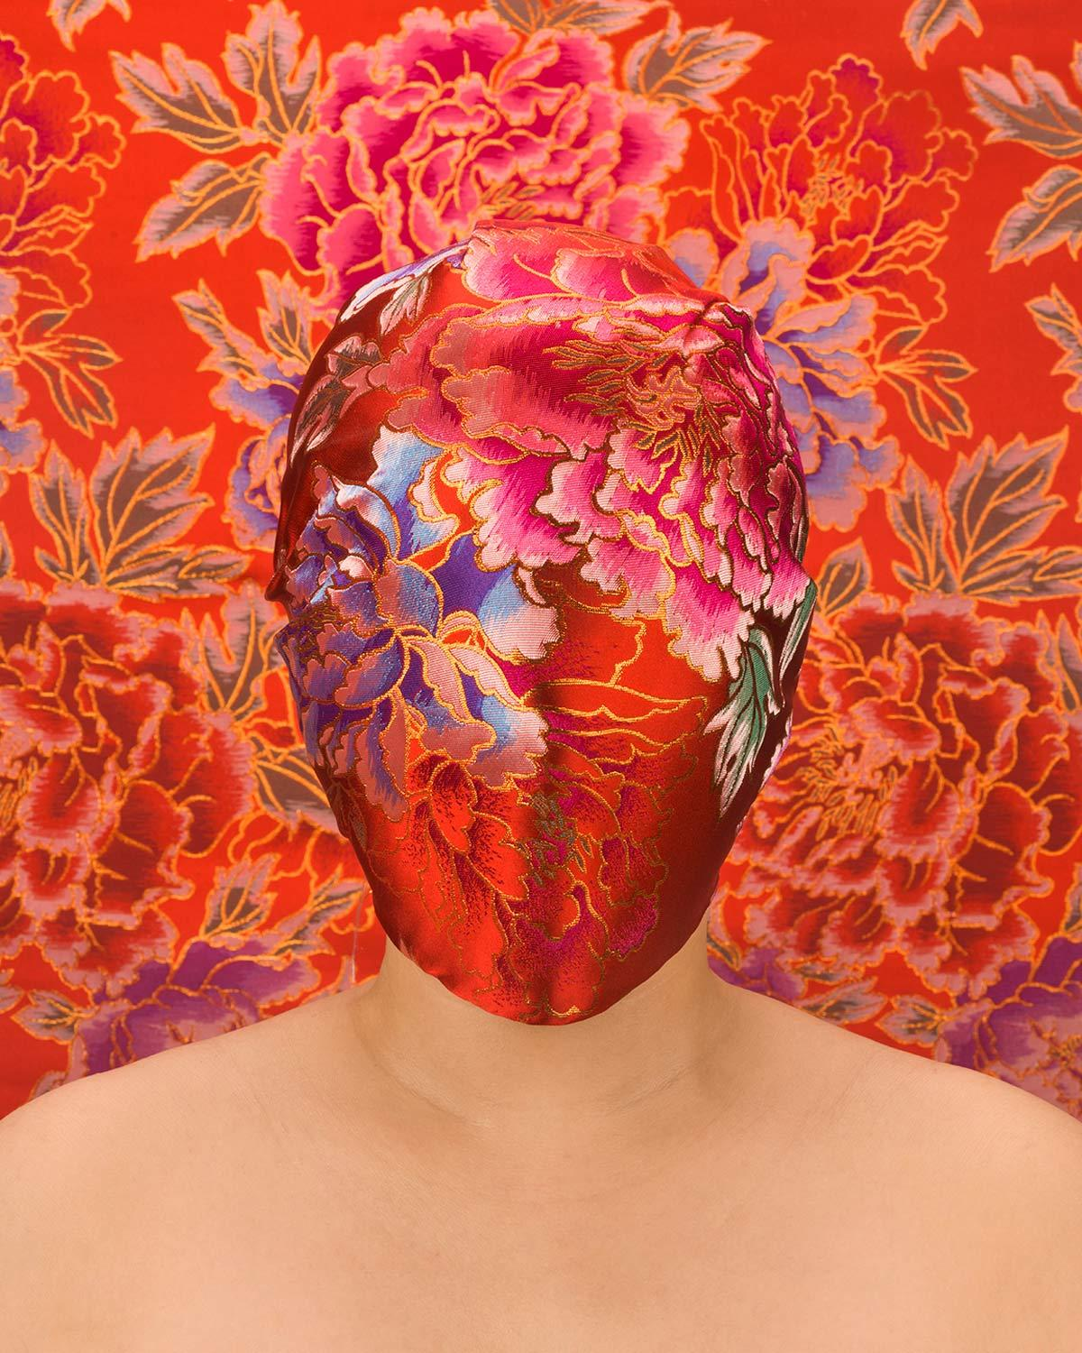
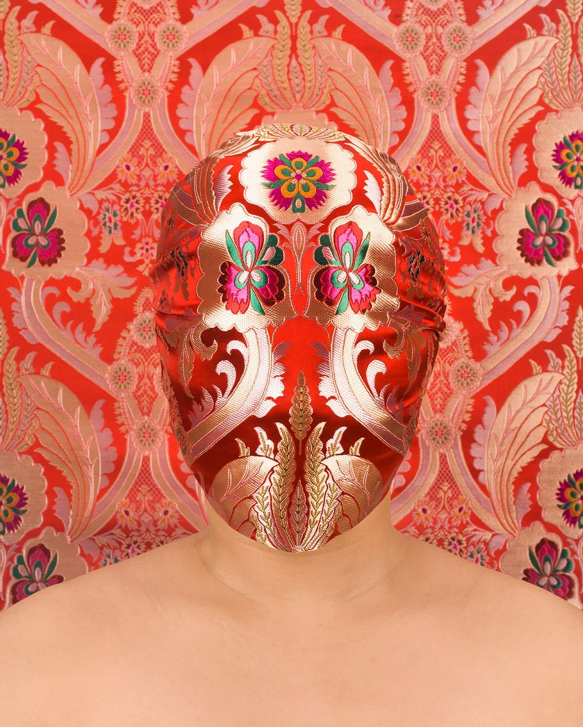
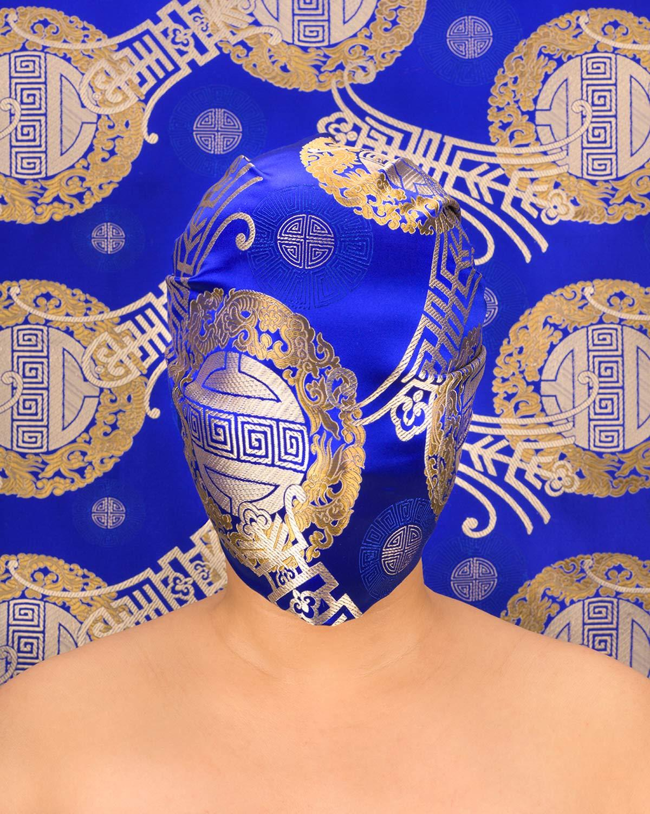
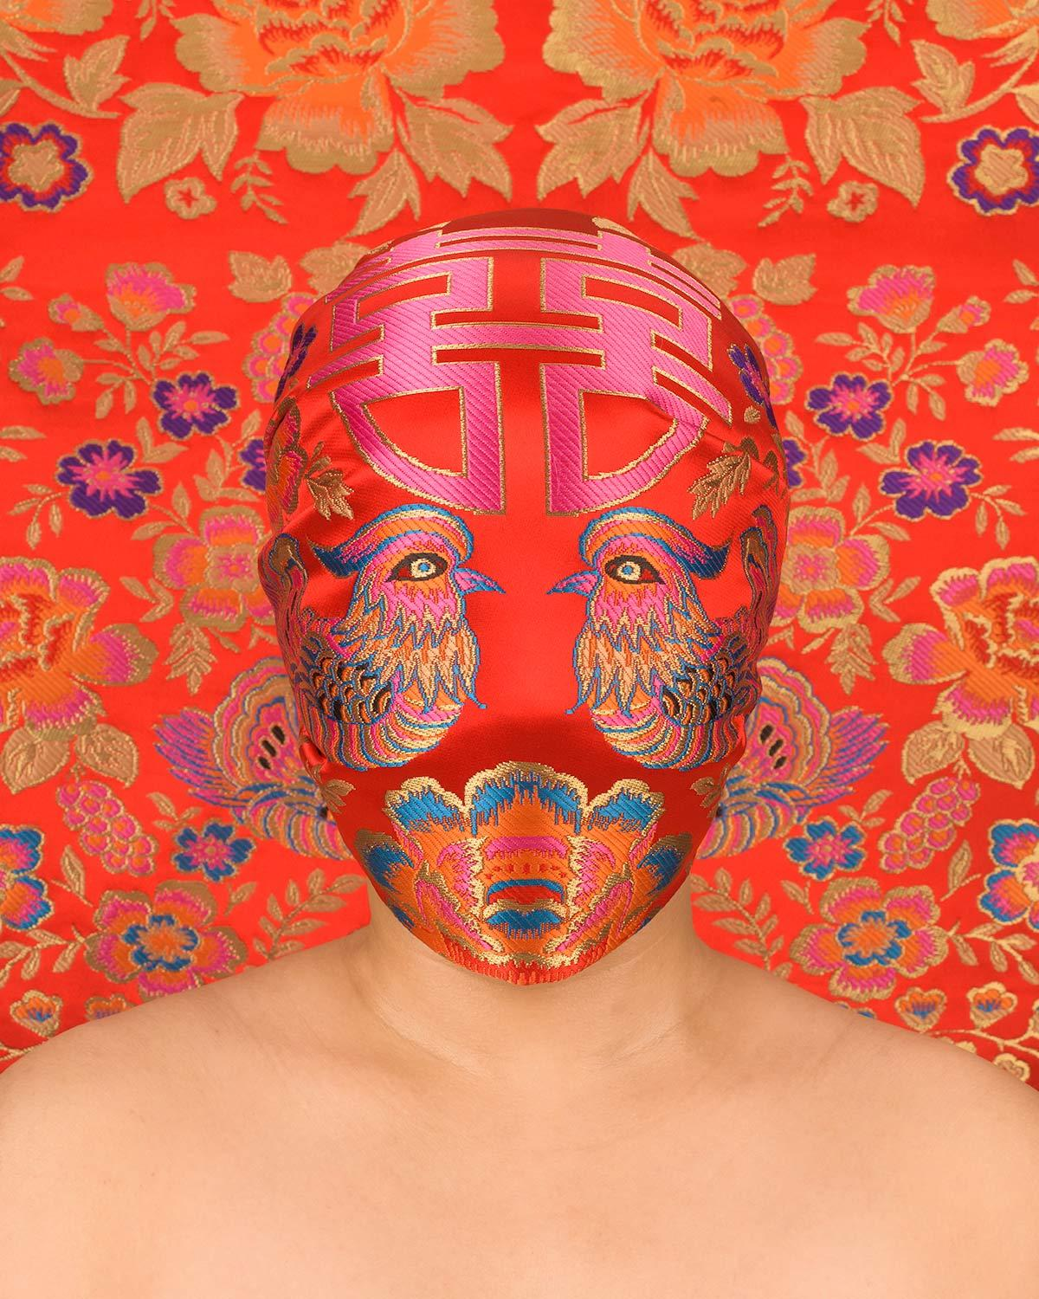
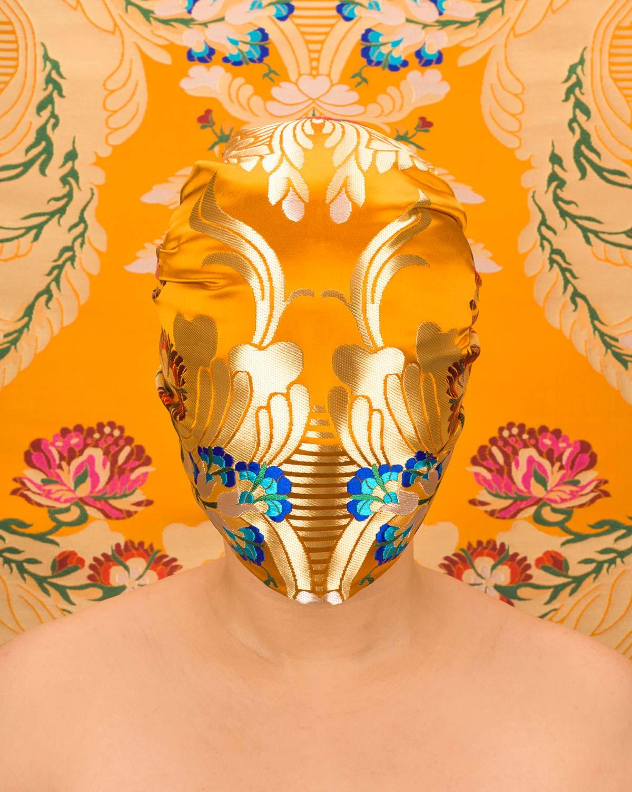
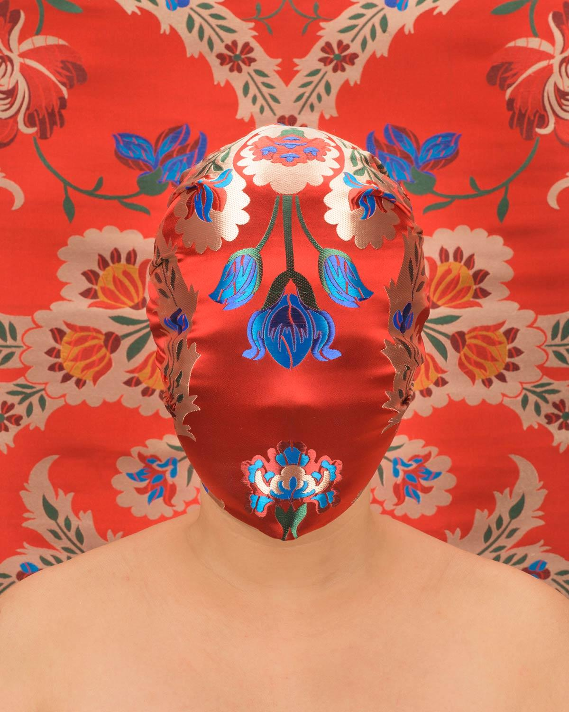
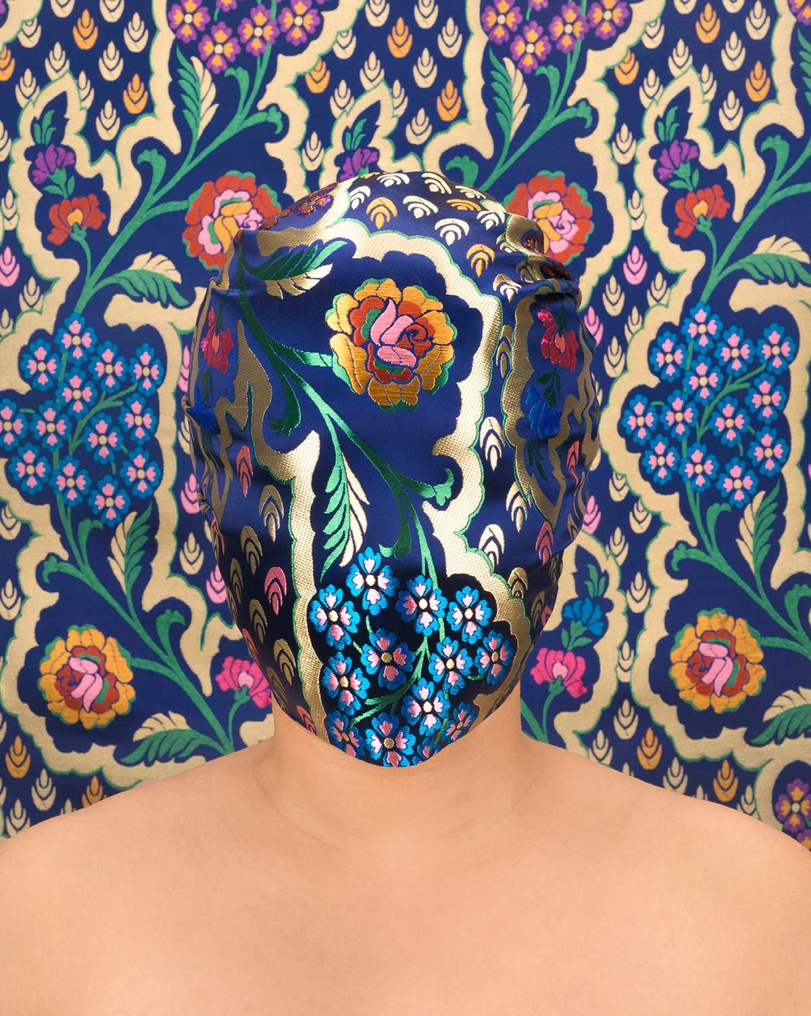
Chun Hua Catherine Dong, Skin Deep, 2016-2020, photograph, varied dimensions.
Notes:
Chun Hua Catherine Dong’s Skin Deep photograph series is one of her many series that explores the concept of shame within Asian culture. Over the course of 27 different photographs, she has covered her face in different Chinese silks that vary in colour and pattern, and positioned herself in a way that appears as if she is posing for an ID-card. According to Catherine, Chinese shame is rooted at the concept of ‘face’, which is precisely why she masks her own face in the series. She goes on to refer to the piece as a symbol for only being seen for her Chinese heritage as an immigrant in Canada, as well as the treatment she faced as a young girl in China. Her role as an artist with this piece is to create a record of her time; in this case, she is symbolically recording the erosure of the identity of herself and many others facing the same circumstances. Over the course of the past 5 years, each photograph that has been added to the series remains identical in content, other than the changing of the silk for each photo. This could be interpreted as the consistency of this reality, as many Asian women still face these problems as they are absorbed into their cultural identity, as well as women everywhere feel the social obligation to remain quiet and ‘masked’. The changing silks represent the individuality of each woman, yet they do not deviate from the norm of their cultural expectations.

Slide 10
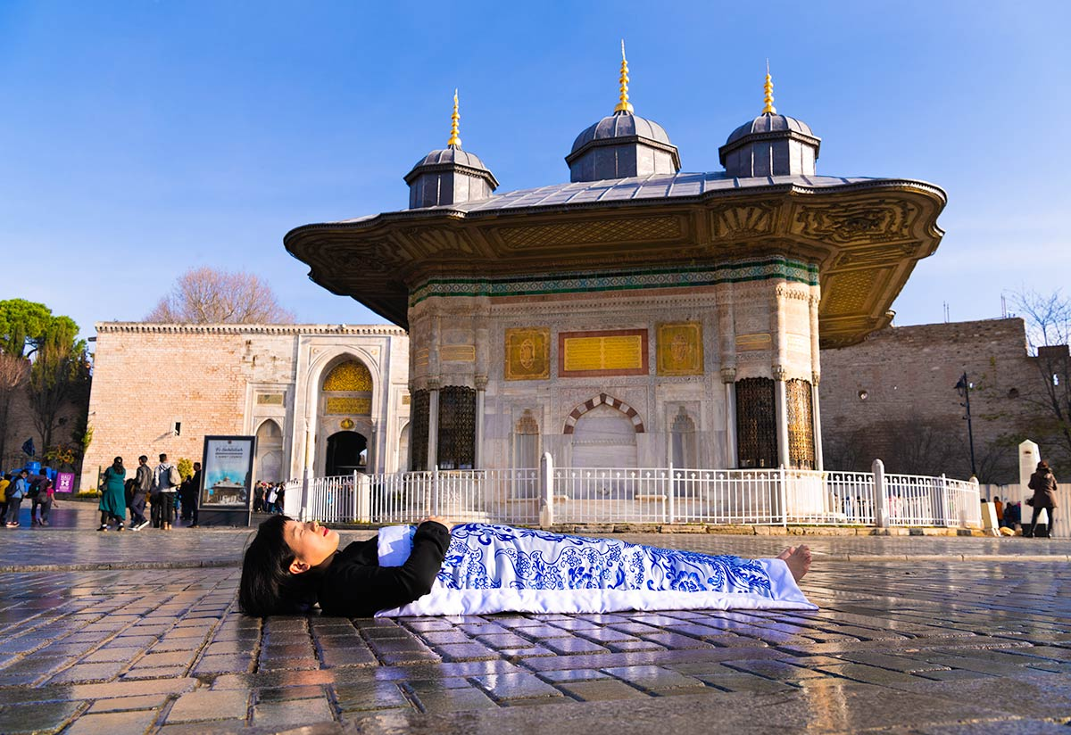
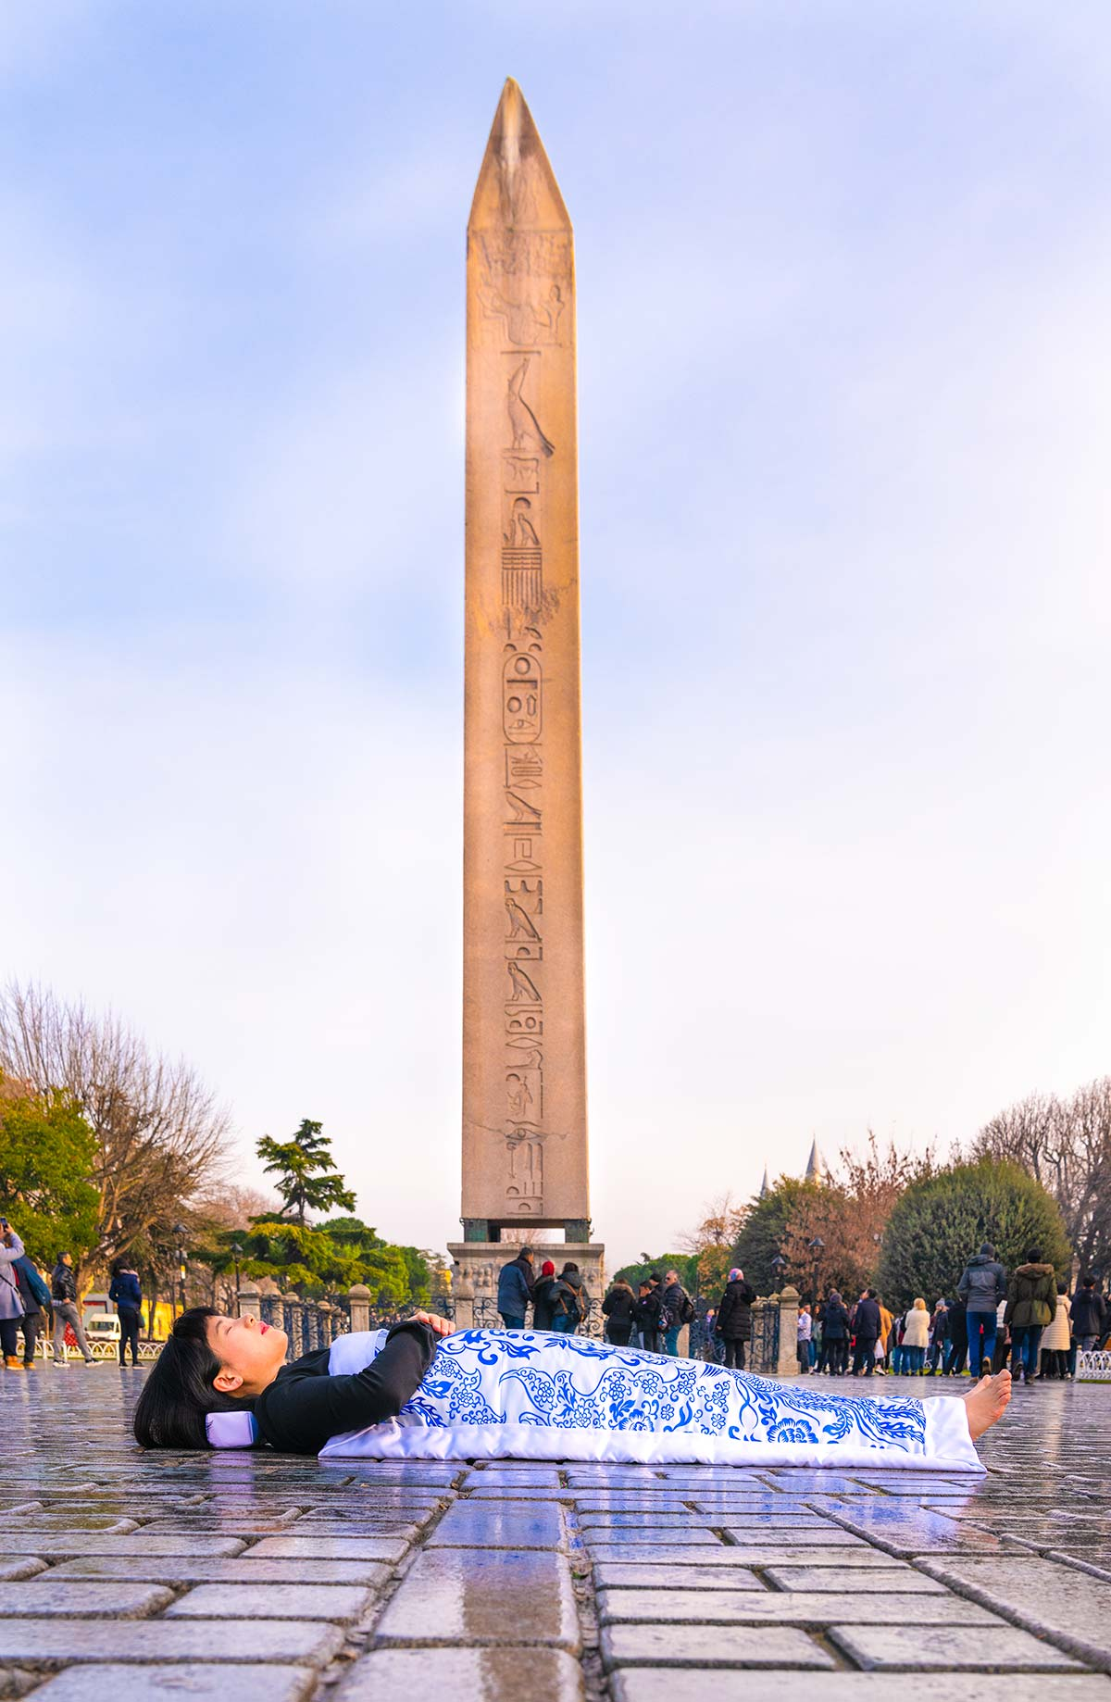
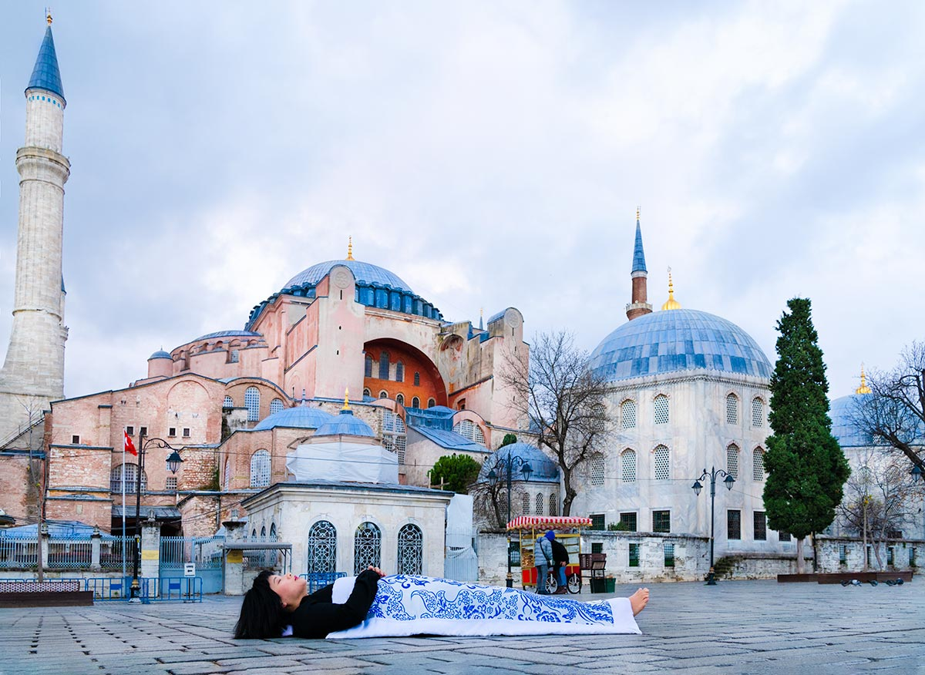
I have been there - Istanbul
Notes:
These are photos from Catherine Dong’s ongoing art series I have been there. These pictures specifically are from her time in istanbul. In this series Catherine repeatedly buries herself publicly in popular locations for tourists. She does this to question ideas about death and belonging as well as how people have moved out of their counties. Her performance is done using a tradition from her hometown in China where each daughter of a person will make a duvet to cover them in at burial. The duvets are made using silk and have Chinese patterns on them as well. The reason she does this performance is because she is uncertain who will bury her when she dies because she lives alone and has no children. She questions death through this performance as the idea comes from a burial practice from her hometown. It questions belonging as she has no one to bury her according to this ritual. Finally it questions the idea of people moving out of their countries as the performance is done at tourist attractions. (Kirstin Couzens)

Slide 11
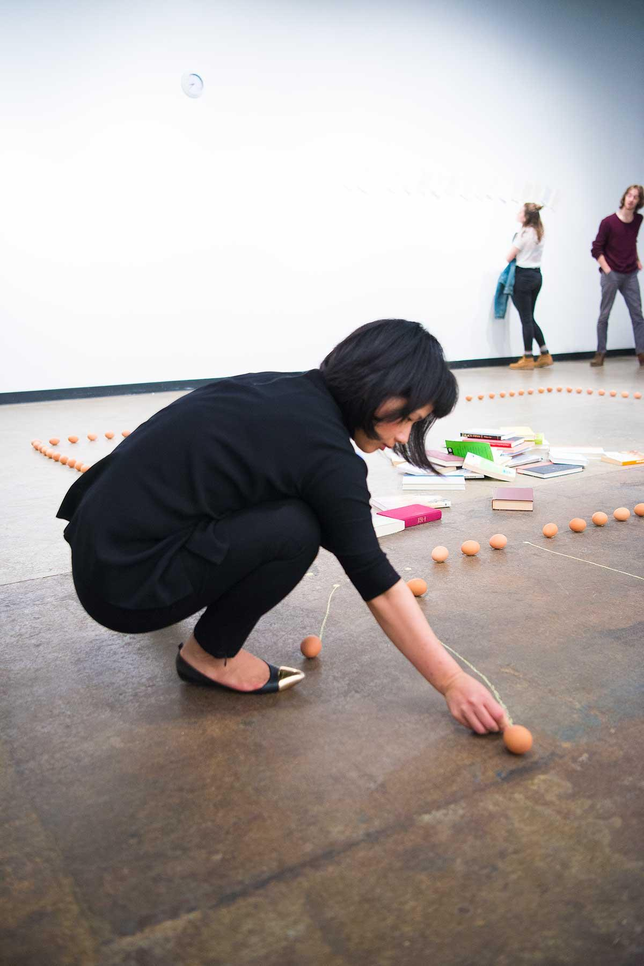
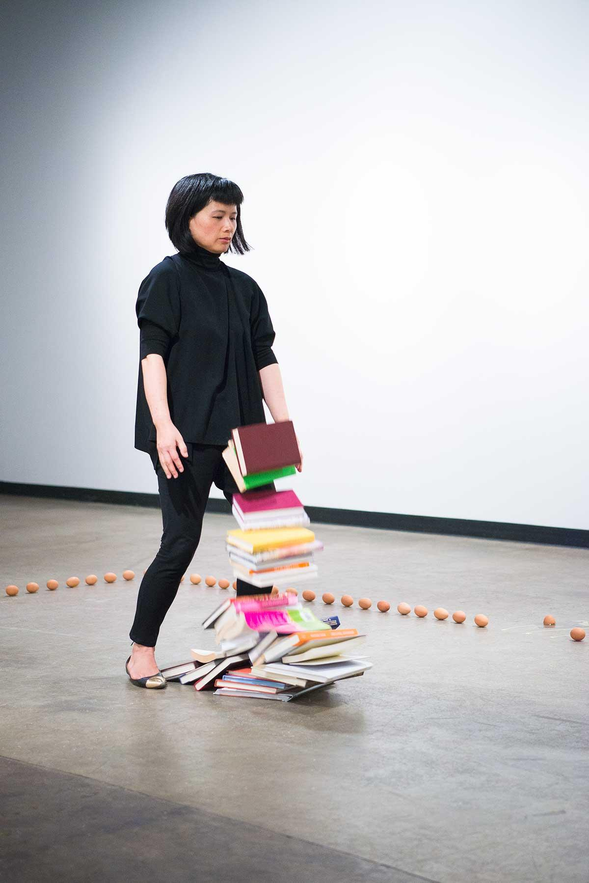
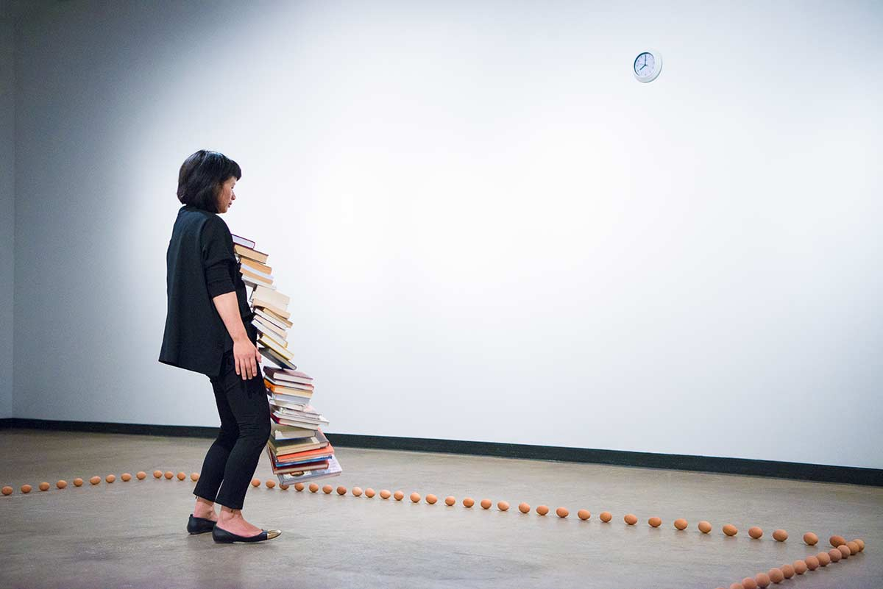
Chun Hua Catherine Dong, To Begin II, 2016, Performance, Contemporary Visual Culture.
https://chunhuacatherinedong.com/portfolio/to-begin-ii/ (Photos done by Mitchell Chalifoux
Notes:
Chun Hua Catherine Dong, To Begin II, is a piece that demonstrates the social norms of constant movement. Dong placed a clock on the wall that she constantly looks at while holding a stack of books. While she is doing this, she stands around eggs that are placed in a rectangle formation. Once Dong becomes tired from holding the books, she drops them, rips out a page from each book, writing the time she dropped them at. The novel may move the eggs around her, but if the egg cracks, then she moves the egg aside with the egg white and yoke tracking behind. The purpose of Dong performing this is to show the functions of society in today’s age. Once the books drop, one is set aside, and the cycle continues until there are no more books left to drop. The books represent the weight of today’s society; either work or school, a balancing act of getting everything done by a certain time, and watch the cycle continue. The eggs represent the tension people feel when working like this. The egg breaking is a symbol of tension being released from the workload. If if the eggs move, it still remains in a similar shape to the one started, symbolizing the constant cycle. The purpose of her writing down the times on the pages is time itself, since time is a concept, and meaningless in society since there is a constant workload. Time is only represented on these pages once “the work load” or the books get too heavy to bear, which in turn get dropped and the time is recorded. Once recorded, Dong places the times on the wall for the audience to interpret and to eventually take home.
The repetitive labour of the task shows how we operate as machines, and commitment towards the repetitive labour. It also explores the thoughts of people's happiness levels in the job they are currently in, due to the repetition. As time goes on, more books are dropped and the weight becomes lighter and less labour intensive. Once all the books have been dropped, Dong becomes static symbolizing the end of the work day. Social transformation can be slow, but can change at anytime and any place. Social shifts with our dynamic workflow will eventually collapse and create new beginnings in our daily lives. (Ekatrina)

Slide 12
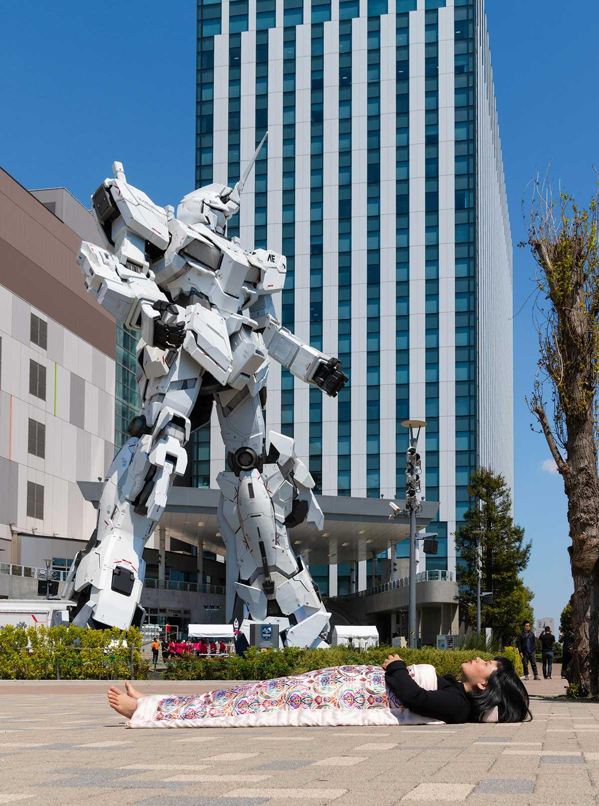
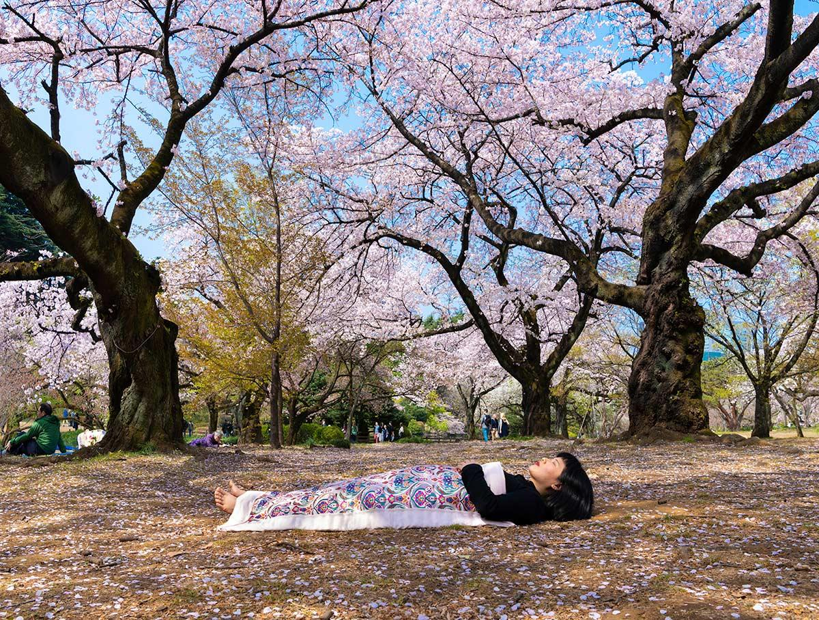
I Have Been There – Tokyo and Kyoto
https://chunhuacatherinedong.com/portfolio/i-have-been-there-tokyo-kyoto/
Notes:
The pieces I chose are from the “I Have Been There” collection, photographed in Tokyo and Kyoto. This performance art collection “explores relationship between death, belonging and diaspora” (Chun Hua Catherine Dong). In each photo she lies down at important landmarks in the cities she visits covered by “a new duvet with Chinese embroidered fabric” which is made for each performance. This is based upon a Chinese tradition where the daughters of the deceased elders cover their body in a duvet (called a shroud). There is one shroud per daughter placed on the bodies. Since Chun Hua Catherine Dong is single, this performance demonstrates her question of who would cover her body if she died. She goes to these places and photographs them to gather a public record of the places she has been in her life. The medium used are digital photographs, shot in colour with a standard lens. The subjects of the photos are both the artist and the landmarks in the background. The first one being a statue from the popular Japanese anime: Neon Genesis Evangelion. The second one being a group of cherry trees- which are native to Japan. (John Pacholik)

Slide 13
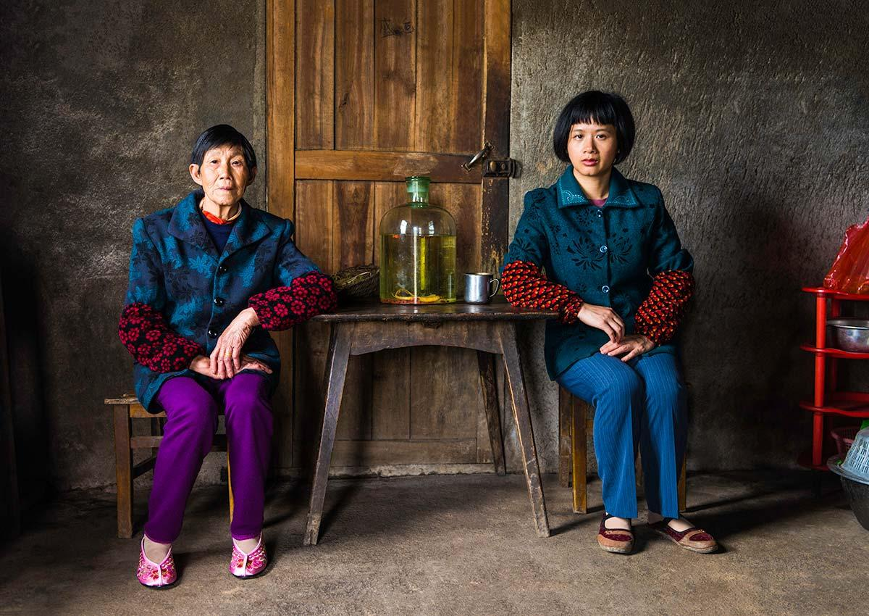
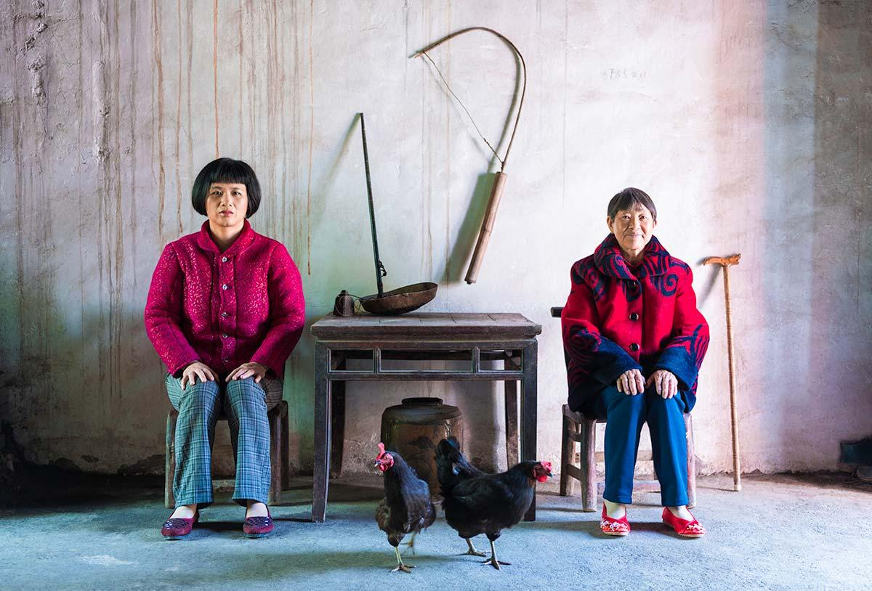
Chun Hua Catherine Dong, Mother, 4 pieces of photographs, inkjet prints, size varies, 2017.
https://chunhuacatherinedong.com/portfolio/mother/
https://www.youtube.com/watch?v=QwMxF1pPtlU&feature=emb_title
Notes:
“Mother” by Chun Hua Catherine Dong consists of 14 photographs and a video dedicated to her absent mother. "Absence is a form of presence". After her mother passed away she went back to China and found 14 mothers to photograph (her mother’s close friends and relatives). After taking photos with each mother, she invited all of them to come together for a group portrait that was later transformed to a video. For video, see the link posted on the slide. This work seeks consolation and restores narrations of the past through visual expression of memories and loss, exploring relationship between life and death, human existence and universal emotions. She used re-enactment as a method of revisiting and re-imagining past.This work reveals how the mother/daughter relationship is experienced as a site of love and care, and how memories cross time and space to create a new experience that not only transcends life and death, bridges past and present, but also transforms emotions and realities. “Mother” is an embodiment of a melancholic longing for an unrecoverable past and a memento mori: a reminder of the inexorable passage of time and the beautiful transience of human life.

Slide 14
Works Cited
“Alone Together – Chun Hua Catherine Dong.” Chun Hua Catherine Dong's Website. Chun Hua Catherine Dong, 2016. https://chunhuacatherinedong.com/portfolio/alone-together/.
“CV – Chun Hua Catherine Dong.” Chun Hua Catherine Dong's Website, 2016. http://chunhuacatherinedong.com/cv/.
“I Have Been There – Istanbul – Chun Hua Catherine Dong.” Chun Hua Catherine Dong's Website. Accessed March 19, 2020. https://chunhuacatherinedong.com/portfolio/i-have-been-there-istanbul/.
“Skin Deep – Chun Hua Catherine Dong.” Chun Hua Catherine Dong's Website. Chun Hua Catherine Dong, 2016. Accessed March 20, 2020. https://chunhuacatherinedong.com/portfolio/skin-deep-2/.
“To Begin – Chun Hua Catherine Dong.” Chun Hua Catherine Dong's Website, 2016. Accessed March 20, 2020 https://chunhuacatherinedong.com/portfolio/to-begin-ii/.
“Pregnancy (1) - Chun Hua Catherine Dong.” Chun Hua Catherine Dong’s Website, 2014. Accessed March 20, 2020
http://chunhuacatherinedong.com/portfolio/pregnancy-i/

Slide 15
Works Cited (Continued)
CHUN HUA CATHERINE DONG BIOGRAPHY. Web Article. Regina: Dunlop Art Gallery. From Dunlop Learning. https://dunloplearning.ca/chun-hua-catherine-dong (Accessed March 20, 2020)
Dong, Chun Hua Catherine. “I Have Been There.” Photograph, 2019. From Chun Hua Catherine Dong. Photograph, colour. https://chunhuacatherinedong.com/portfolio/i-have-been-there-tokyo-kyoto/ (accessed March 20, 2020).
Dong, Chun Hua Catherine. “I Have Been There.” Web Article, 2019. From Chun Hua Catherine Dong. https://chunhuacatherinedong.com/portfolio/i-have-been-there-tokyo-kyoto/ (accessed March 20, 2020).
“Everywhere and All at Once - Chun Hua Catherine Dong.”Web Article,2017.From Chun Hua Catherine Dong https://chunhuacatherinedong.com/potfolio/4781 /everywhere-and-all-at-once (accessed March 21,2020)
“The Sign - Chun Hua Catherine Dong.”Web Article,2017.From Chun Hua Catherine Dong https://chunhuacatherinedong.com/portfolio/the-sign/ (accessed March 21,2020)

